Slide 1
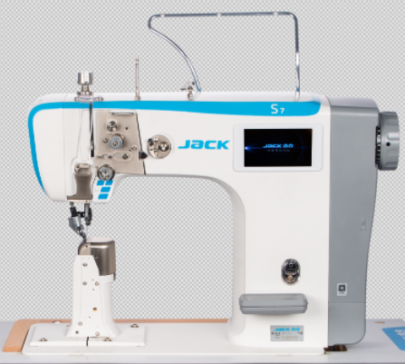
S7 intelligent control computerized post bed roller feed sewing machine
2020.10

Slide 2
Content
1.Naming rules
2.Product description 3.Product selling point

Slide 3
1.Naming rules
S
7
—
9
1
—
/
X
T
Brand | Model | — | Type | Needle | Feature 1 | Feature 2
Brand
S | Jack
Type
8 | Thin column
9 | Standard column
Feature 1
/ | Import hook
Model
7 | Stepper roller machine
7+ | IoT Stepper roller machine
Needle no.
1 | Single needle
2 | Double needle
Feature 2（optional）
X | Short trimmer
D | Bobbin thread detection
Sequence：：XD
Feature 3
T | Touch panel
/ | Button screen

Slide 4
2.Product description
S7 intelligent control computerized post bed roller feed sewing machine，It also adopts Jack new design and equips with stepper motor controlled feeding system. formed by main shaft servo motor and three stepper motors. It has many automatic functions like trimmer, reverse sewing, auto presser foot lifter, as well as other functions like touch panel, rotary type presser foot pressure adjustment device, digitized needle gauge adjustment, multi-needle gauge switch system etc, Super value-added functions like short thread remaining function, bobbin thread detection function & IoT function is also optional.
The factory and optimum speed of single needle machine is 2200RPM,double needle is 1800RPM
model | S7-91 (single needle) | S7-92(double needle)
stitch | 301（lock stitch） | 301（lock stitch）
factory /max speed | 2200rpm/2500rpm | 1800rpm/2200rpm
presser foot lifting mode | by hand、knee、automatic | by hand、knee、automatic
presser foot lifting height | by hand 6mm/knee 12mm /auto 10mm | by hand 6mm/knee 12mm /auto 10mm
auto trimmer | √ | √
auto reverse and reinforce | √ | √
maximun reinforce stitches | 15 | 15
needle | DP×5#16 | DP×5#16
maximun stitch length | 7mm | 5mm
needle bar stroke | 41 mm | 41 mm
drive mode | embedded direct drive servo motor | embedded direct drive servo motor
operating voltage | 220V | 220V
driving power | 750W | 750W
the way to add oil | hook automatic add oil | hook automatic add oil
automatic control mode | stepper motors、electromagnet | stepper motors、electromagnet

Slide 5
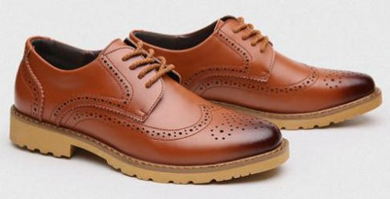
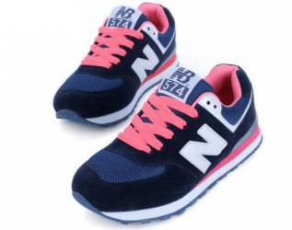
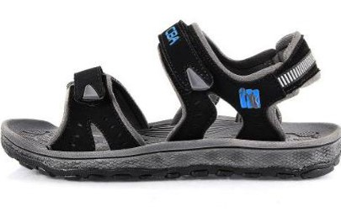
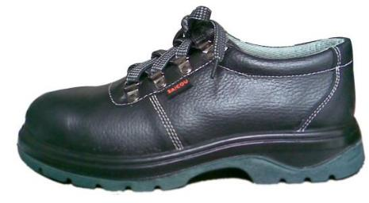
2.Product description-Applicable sewing products
It is suitable for vamp sewing of genuine leather shoes, casual shoes, children's shoes, sneakers, beach sandals, labor shoes, etc.
genuine leather shoes
sneakers
beach sandals
labor shoes

Slide 6
3.Product description-detail technical parameters
Machine model | Needle (mm) | Maximum stitch length （mm） | Presser foot listing height （mm） | Needle bar moving range (mm) | Max speed （r.p.m） | Auto trimmer | Auto presser foot lifter | Auto reverse sewing | Short thread tail | Volume(mm) | Weight(kg)
S7-91-T | DP×5 9-23# | 5 | 12 | 41 | 2500 | √ | √ | √ |  | 882×375×794 | 63/72
S7-92-T | DP×5 9-23# | 5 | 12 | 41 | 2200 | √ | √ | √ |  | 882×375×794 | 63/72
S7-91CX-T | DP×5 9-23# | 5 | 12 | 41 | 2500 | √ | √ | √ | √ | 882×375×794 | 63/72
S7-91 | DP×5 9-23# | 5 | 12 | 41 | 2500 | √ | √ | √ |  | 882×375×794 | 63/72
S7-92 | DP×5 9-23# | 5 | 12 | 41 | 2200 | √ | √ | √ |  | 882×375×794 | 63/72
S7-91CX | DP×5 9-23# | 5 | 12 | 41 | 2500 | √ | √ | √ | √ | 882×375×794 | 63/72

Slide 7
3.Selling Points（1/2）
No. | Classification | Selling points | Features | Advantages
1 | Smart and efficient | Stepper motor drive , intelligent operation | Up & down roller and needle are all controlled by independent stepper motor | same needle gauge and high accurate reverse sewing , more stable
 |  | Pressure adjustment , easy to adjust | Rotary type pressure adjustment screw is available to achieve simple, direct adjustment. | pressure adjustment more precise and easier
2
 |  | Different stitch gauge, free switching | Sewing gauge can be digitize adjusted under programmable sewing mode based on different sewing demands. | Solve the problem that the stitch length becomes smaller when corner sewing, and realize the perfect overlap of stitches.
3
 |  | Electromechanical integration, energy saving efficiency | Automatic functions like trimmer, reverse sewing, auto presser foot lifter, electromechanical integration. | The maintenance is simple, and the automatic operation efficiency is high, and the production is fast.
4
5 | Exellent performace | High accurate stitch | Reverse sewing are mainly optimized through mechanical and electronic control, and the rate of overlap is further improved. | It more accurate to stitch heavy stitches on sewing multi-layer thick materials.
 |  | Strong adaptability, beautiful stitch | It ensures same needle gauge and high accurate reverse sewing and avoids thread loose during narrow stitch in different sewing part like different fabric thickness, corner sewing, and slope sewing. | Strong adaptability to achieve consistent stitch length and beautiful stitches.
6
 |  | Short Thread Remaining | The innovative design of the thread trimming mechanism. | Within 3mm after thread trimming, no need to trim, saving time and reducing labor cost.
7
 |  | Strong puncture ability | It can penetrate more than 110 layers of A4 paper | The super thick fabric of labor shoes can sew easily.
8

Slide 8
3.Selling Points（2/2）
No. | Classification | Selling points | Features | Advantages
9 | Convenient service | Good heat dissipation,long life | Through the design of hand wheel with fan blade and large area of electric control heat sink | Compared with other brands, the temperature is about 4 ℃ lower, and the service life of electronic components is longer.
10 |  | Two color lamp | Unique two color lamp | It can guide workers to sew according to the light track to ensure the beautiful line trace.
11 |  | Floding backtacking wrench design | The backtacking wrench adopts double-layer design | The backtack can be controlled by the arm without the need of finger pressing.
12 | Operation panel Flexible choice | Touch panel | 5.0 inches big touch panel makes you easy to operate and understand. | Operators can freely switch sewing mode between free sewing mode, overlap sewing mode, fixed needle sewing mode and programmable sewing mode.
13 |  | Button panel | The panel has been optimized design, the interface is simple and generous, integrated voice navigation key, one-key recovery key, etc. | One key to restore factory parameters ; One key to restore user parameters ; the parameters will restore the user saved parameters. Can effectively solve the novice misuse.

Slide 9
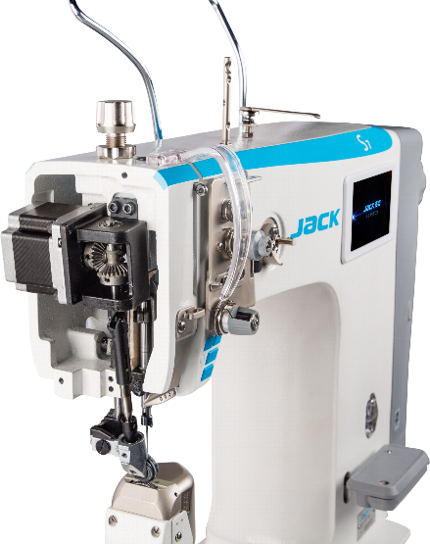
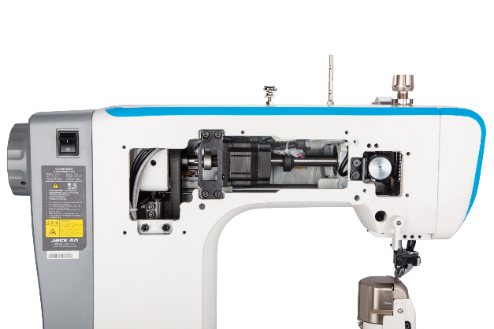
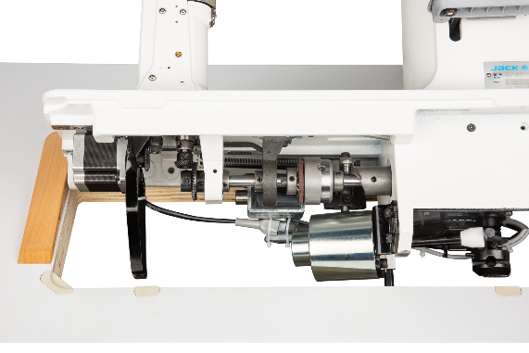
3. Smart and efficient—Stepper motor drive , intelligent operation
Up & down roller and needle are all controlled by independent stepper motor, it can be edited and ensures same needle gauge and high accurate reverse sewing and avoids thread loose during narrow stitch in different sewing part like different fabric thickness, corner sewing, and slope sewing.
up roller stepper motor
down roller stepper motor
needle stepper motor

Slide 10
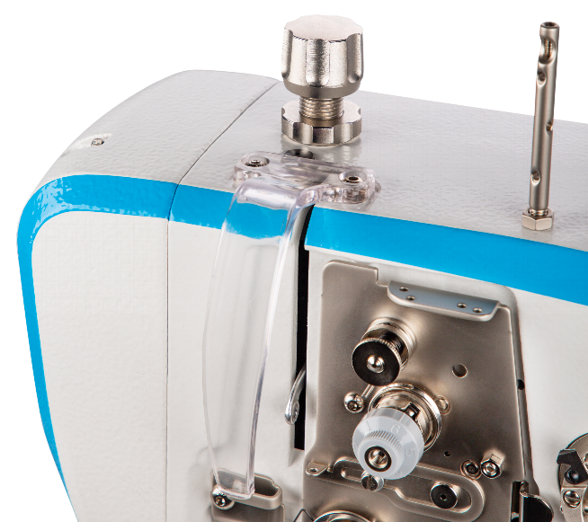
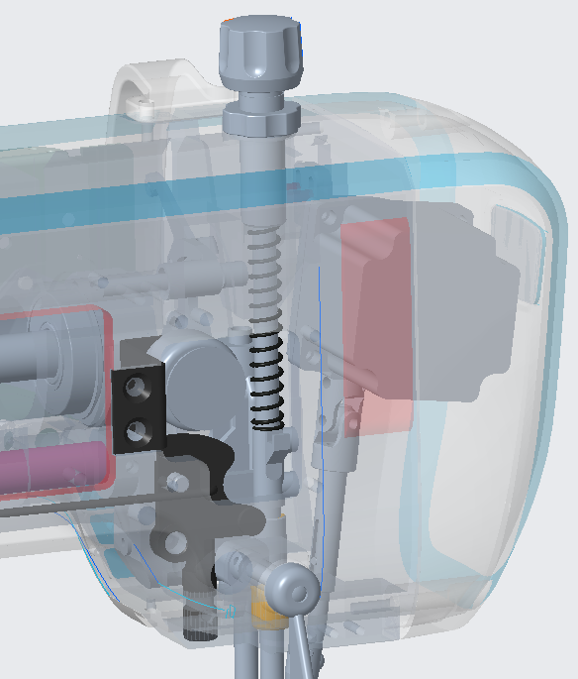
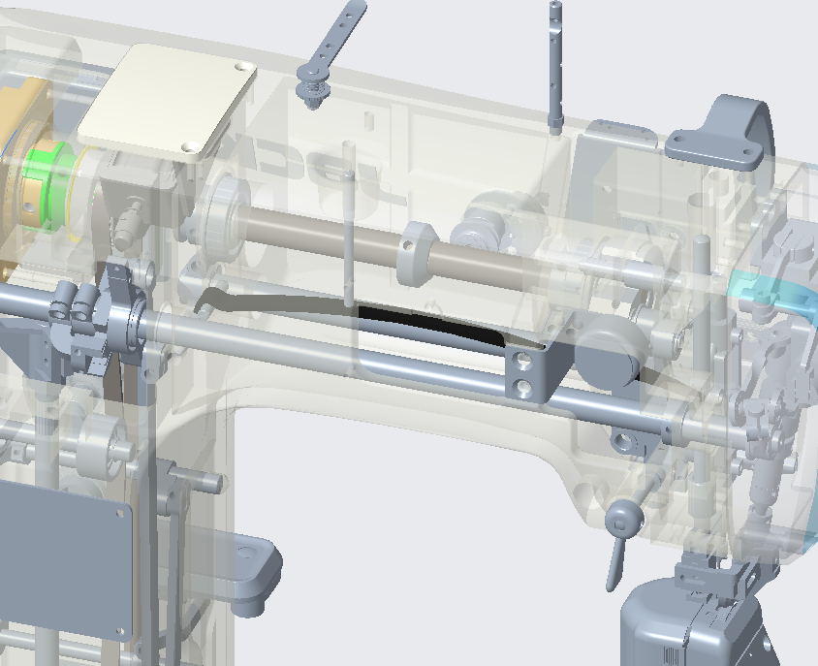
3. Smart and efficient—Rotary type pressure adjustment , easy to adjust
Rotary type pressure adjustment screw is available to achieve simple, direct & precise adjustment.
S7 new pressure adjustment
normal machine

Slide 11
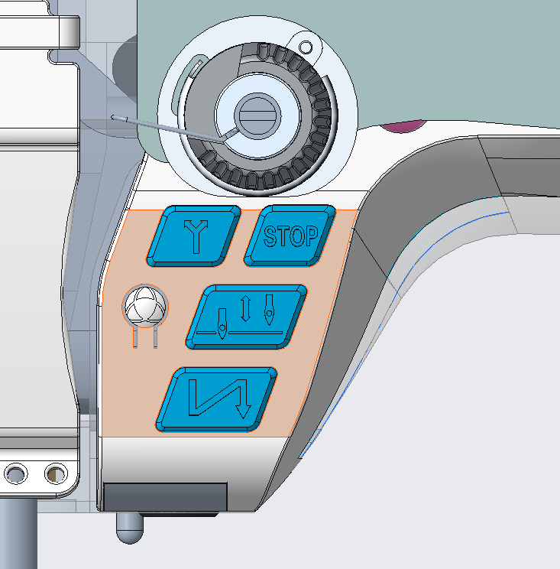
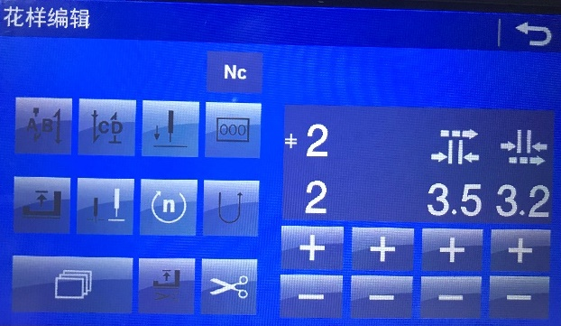
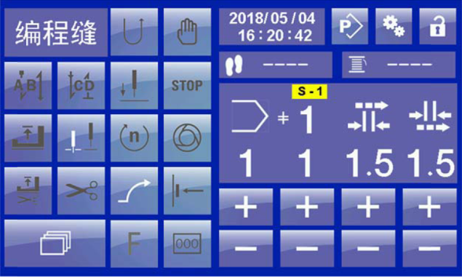
3. Smart and efficient—Different stitch gauge, free switching
Sewing gauge can be digitize adjusted under programmable sewing mode based on different sewing demands. It also has fast key on machine head light to precisely choose needle gauge among multi-needle gauge switch system.
multi-needle gauge switch system
Pattern editing
programmable sewing mode

Slide 12
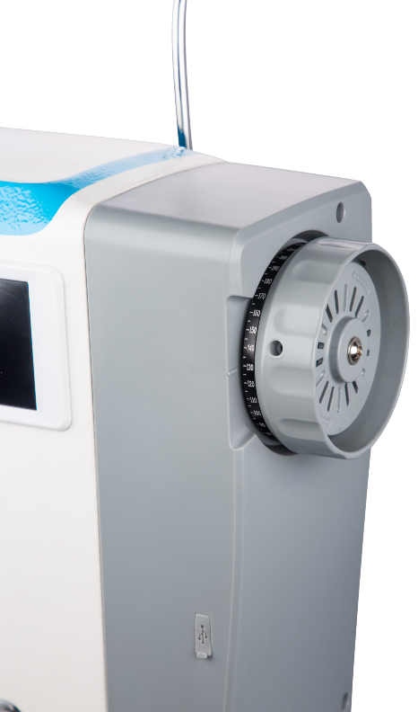
3. Smart and efficient—Electromechanical integration, energy saving efficiency
Automatic functions like trimmer, reverse sewing, auto presser foot lifter, electromechanical integration. The maintenance is simple, and the automatic operation efficiency is high, and the production is fast.

Slide 13
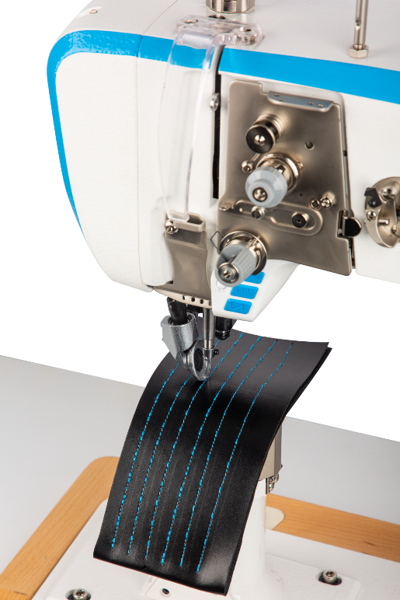
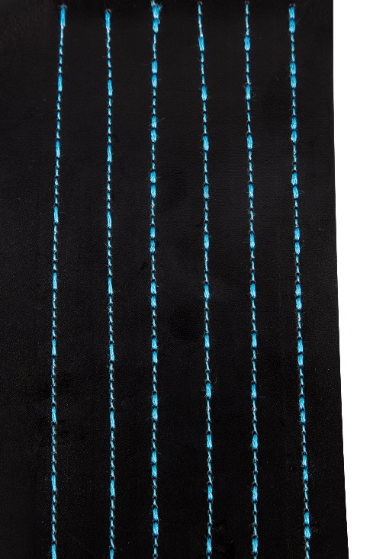
3. Exellent performace—High accurate stitch
Reverse sewing are mainly optimized through mechanical and electronic control, and the rate of overlap is further improved ; and it more accurate to stitch heavy stitches on sewing multi-layer thick materials.

Slide 14
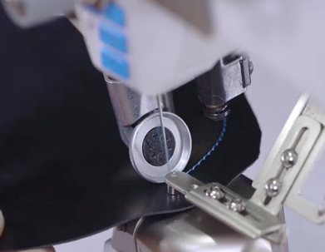
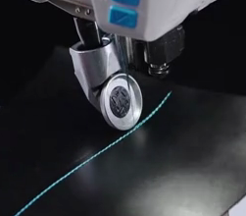
3. Exellent performace—Strong adaptability, beautiful stitch
It ensures same needle gauge and high accurate reverse sewing and avoids thread loose during narrow stitch in different sewing part like different fabric thickness, corner sewing, and slope sewing.

Slide 15
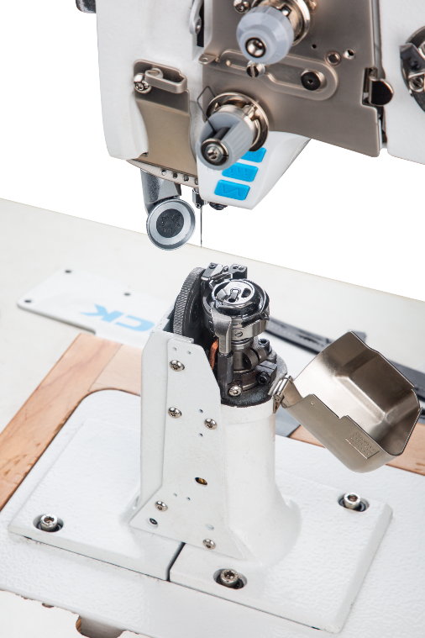
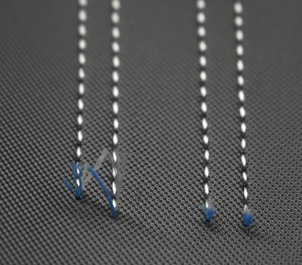
3. Excellent performance-Short Thread Remaining（optional）
The innovative design of the thread trimming mechanism enables the tail within 3mm after thread trimming, no need to trim the thread tail, saving time and reducing labor cost.
No more trim

Slide 16
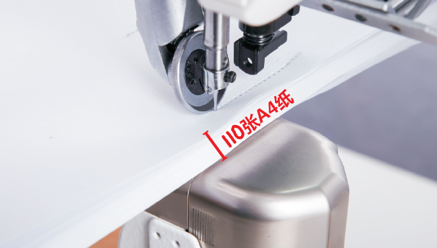
3. Excellent performance-Strong puncture ability
It can penetrate more than 110 layers of A4 paper, and the super thick fabric of labor shoes can sew easily.
110 layers of A4 paper

Slide 17
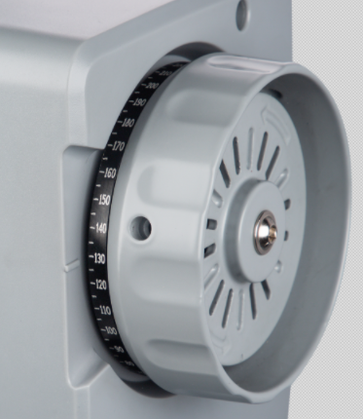
3. Convenient service - Good heat dissipation and long service life
Through the design of hand wheel with fan blade and large area of electric control heat sink, compared with other brands, the temperature is about 4 ℃ lower, and the service life of electronic components is longer. Aluminum handwheel has finger print , fan blade and calibration loop.

Slide 18
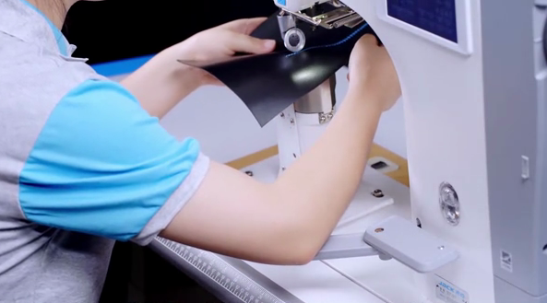
3. Convenient service - Reverse sewing easily
The reverse wrench adopts double-layer design, and the lower layer can rotate freely. When sewing, the reverse sewing can be controlled by the arm without the need of finger pressing.

Slide 19
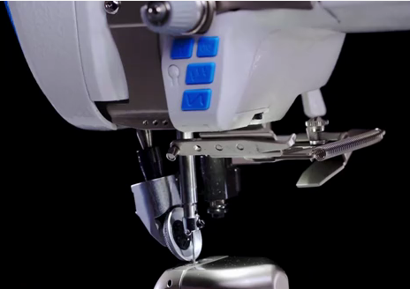
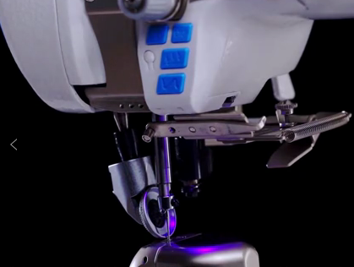
3. Convenient service—Unique bi-colour light
Unique bi-colour light can guide workers to sew according to the light track to ensure the beautiful line trace.

Slide 20
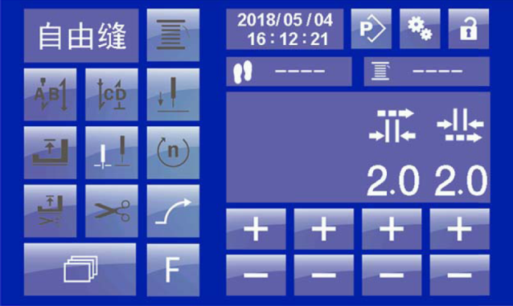
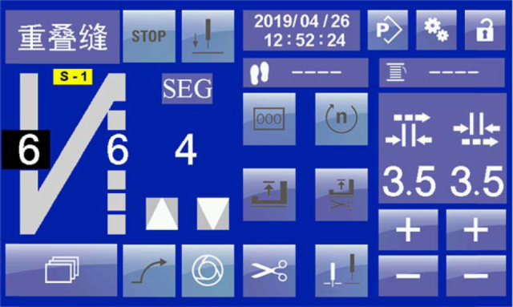
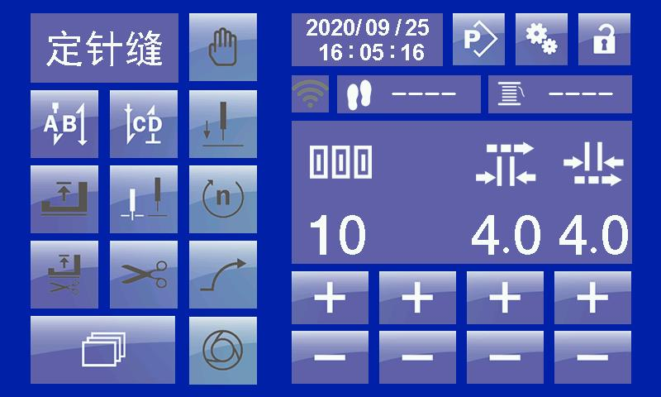
3. Touch operation panel
5.0 inches big touch panel makes you easy to operate and understand. Operators can freely switch sewing mode between free sewing mode, overlap sewing mode, fixed needle sewing mode and programmable sewing mode.
Panel operation instructions-sewing mode switching :
1.Step on the pedal to trim and end the current program;
2.Touch the button shown to switch among the four modes of free sewing,
overlap sewing, fixed needle sewing and programmable sewing.

Slide 21


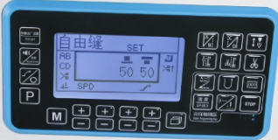
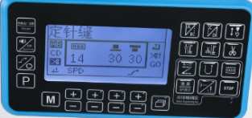
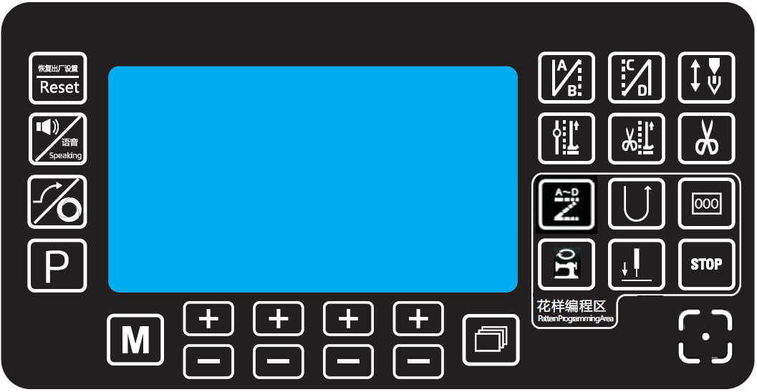
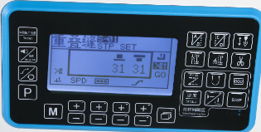
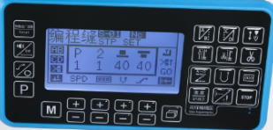
3. Button operation panel
1.The panel has been optimized design, the interface is simple and generous, integrated voice navigation key, one-key recovery key, etc.
2. One key to restore factory parameters ; One key to restore user parameters: press the 1.5 second restore button, the parameters will restore the user saved parameters. Can effectively solve the novice misuse.
Detailed description:
1. Press the voice navigation button to broadcast the cause of the failure and its solution
2. Pressing the voice button during broadcast will stop the current broadcast content. (Failure recovery, voice stop broadcasting)
Note:Touch the M button shown to switch among the four modes of free sewing,
overlap sewing, fixed needle sewing and programmable sewing.

Slide 22



