Slide 1
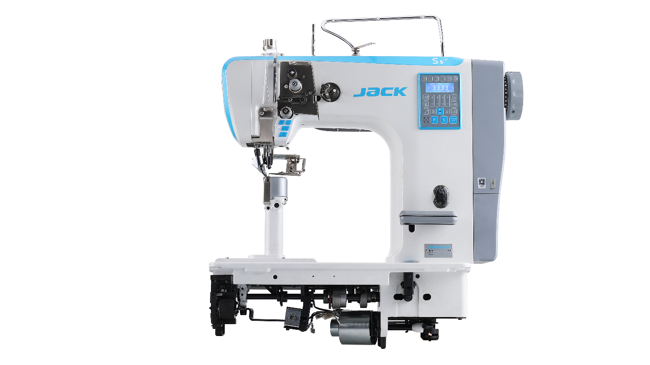
S5-81CX Slim POST BED Single nEEdLE Computerized roller sewing machine
2022.5

Slide 2
Content
1、Naming rules
2、Product description 3、Product selling point

Slide 3
1、Naming rules
S
5
-
8
1
C
X
Brand | Model | — | Type | Needle | Feature 1 | Feature 2
机型
S | Roller machine
柱型
8 | Slim post
特征识别1
C | Chinese hook
主型号
5 | Computerized
7 | Stepper Intelligent
针数
1 | Single needle
特征识别2
X | Short trimmer

Slide 4
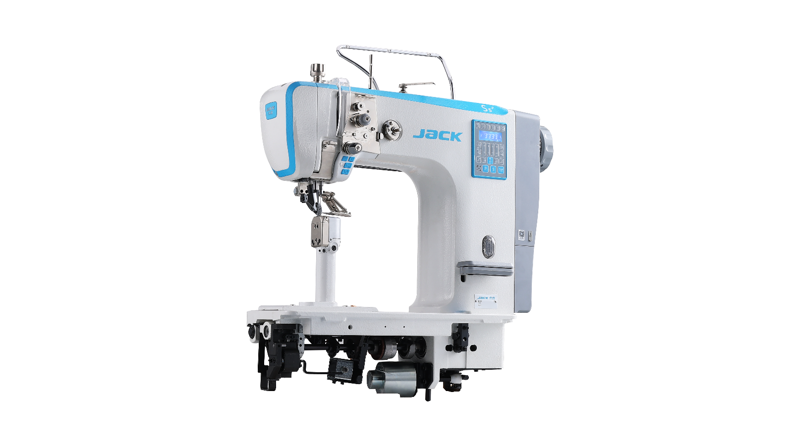
2、Product description
S5-81CX Slim post-bed computerized roller machine, It adopts a slim post design, removable needle plate, multi language, voice navigation ,auto thread cutting(with 3mm short trimmer), auto reverse sewing, auto presser foot lifting, embedded operation panel,one key to reset, and IoT function is also optional.
Note： The factory and optimum speed of single needle machine is 2200RPM.
model | S5-81CX
stitch | 301（lock stitch）
factory /max speed | 2200rpm/3000rpm
presser foot lifting mode | by hand、knee、automatic
presser foot lifting height | by hand 6mm/knee 10mm /auto 10mm
auto trimmer | √
auto reverse and reinforce | √
maximum reinforce stitches | 9
needle | INDPX5#16
maximum stitch length | 6.3mm
needle bar stroke | 41 mm
drive mode | embedded direct drive servo motor
operating voltage | 220V
driving power | 750W
the way to add oil | hook automatic add oil
automatic control mode | electromagnet

Slide 5
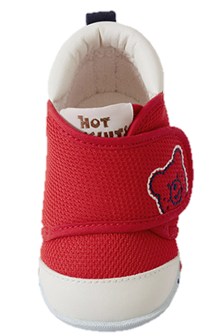
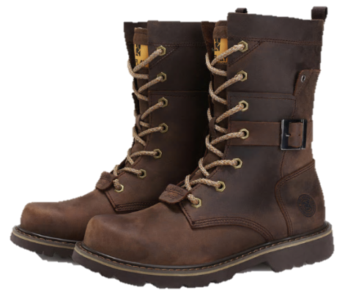
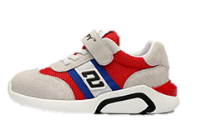
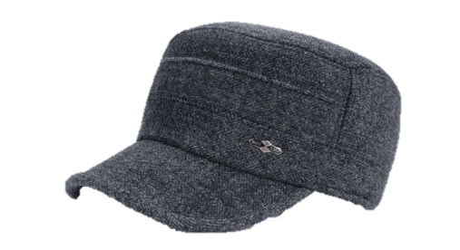
2、Product description-Applicable sewing products
It is suitable for Children's shoes, baby shoes, riding boots, hats, gloves, handbags, etc.
riding boots
Children's shoes
baby shoes
hats

Slide 6
2、Product description-detail technical parameters
Machine model | Max speed s.p.m | Presser foot listing height | Max stitch length（mm) | Needle bar moving range (mm) | Needle (mm) | Auto trimmer | Auto presser foot lifter | Auto reverse sewing | Short thread tail | Volume(mm) | Weight(kg)
S5-81CX | 3000 | INDPX5#16 | 12 | 6.3 | 41 | √ | √ | √ | √ | 812x375x724 | 67/76

Slide 7
3.Selling Points
No. | Selling points | Features | Advantages
1 | Slim post design, wide adaptability | It adopts a slim post design, | Which is suitable for sewing the bottom, side and corners of small products.
2 | Removable needle plate, convenient to debug | Removable needle plate, convenient to debug | The needle plate needs to be replaced to sew different fabrics without replacing large components, and the maintenance cost is low.
3 | Auto thread cutting, efficient sewing | Auto thread cutting | Auto reverse sewing, auto presser foot lifting, electronic control integrated design, simple maintenance and high efficiency.
4 | Short thread remaining, no more trim | The innovative design of the thread trimming mechanism | Within 3mm after thread trimming, no need to trim the thread tail, saving time and reducing labor cost.
5 | Voice guide , easy to use | 1. After the fault alarm, press the "voice key" to automatically broadcast the solution; 2. Each button has a voice prompt | 1.Customers can solve simple problems by voice； 2.Voice prompt enables the operator to clear the key function and ensure full use of the function.
6 | One key to reset | One key to reset | Users no longer have to worry about misuse.
7 | Dual USB interface | It is equipped with charging interface and software upgrade interface as standard | At present, other brands only have charging interface, but no software upgrade interface.
8 | Embedded operation panel | Embedded operation panel | It is convenient and simple for users to set and operate the electric control, and it is also more convenient and economical to replace.
9 | Strong puncture ability | It can penetrate more than 110 layers of A4 paper | The super thick fabric of labor shoes can sew easily.

Slide 8
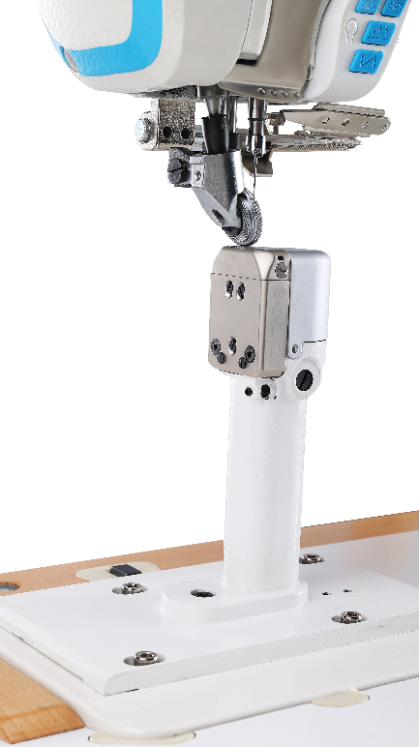
3.Slim post design, wide adaptability （1/9）
It adopts a slim post design, which is suitable for sewing the bottom, side and corners of small products.（Such as Children's shoes, baby shoes, riding boots, hats, gloves, handbags, etc. ）
180mm

Slide 9
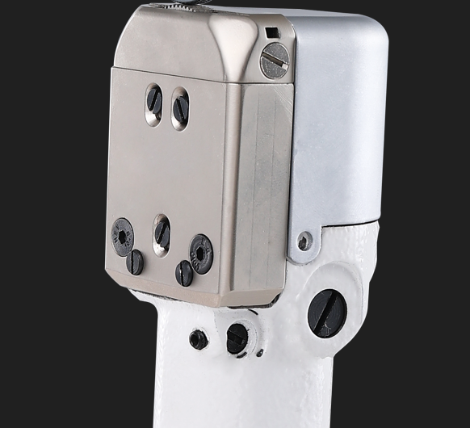
3. Removable needle plate, convenient to debug （2/9）
The needle plate needs to be replaced to sew different fabrics without replacing large components, and the maintenance cost is low.

Slide 10
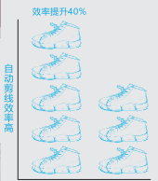
3. Auto thread cutting, efficient sewing（3/9）
Automatic thread cutting, automatic reverse sewing, automatic presser foot lifting, electronic control integrated design, simple maintenance, high efficiency of automatic operation and high output.

Slide 11
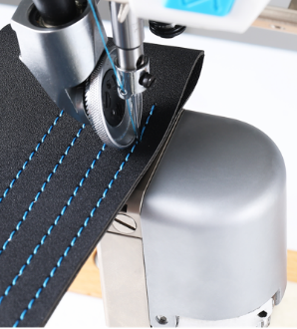
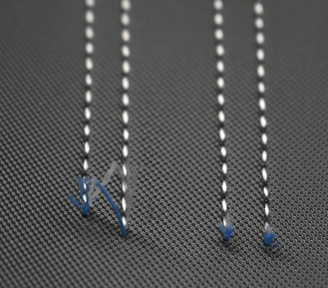
3.Short thread remaining, no more trim（4/9）
The innovative design of the thread trimming mechanism enables the tail within 3mm after thread trimming, no need to trim the thread tail, saving time and reducing labor cost.
No more trim

Slide 12


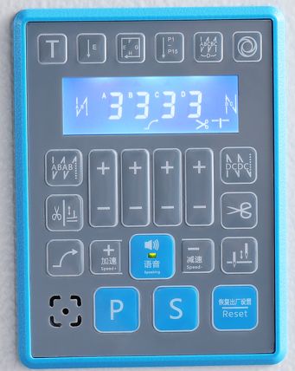
3.Voice guide , easy to use（5/9）
Voice guide：1）Customers can solve simple problems by voice；
2）Voice prompt enables the operator to clear the key function and ensure
full use of the function.
Detail discription：
1、Press the voice button, machine broadcast the reason of error and give the solution（pls try to reset or restart ,if it does not work ,contact local agents or call 4008876858”）
2、Pressing the voice button while broadcasting will stop the current broadcast content. (failure recovery, voice stop broadcast)
The 11 languages are Chinese, English, Bengali, Vietnamese, Czech, Portuguese, Spanish, Hindi, Burmese, Cambodian and Italian.

Slide 13


3.One key to reset（6/9）
Restore factory settings：Users no longer have to worry about misuse.
One key to reset：press 1.5s this parameter will restore the user save parameters.

Slide 14
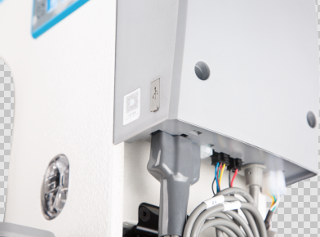
3.Dual USB interface（7/9）
Dual USB interface：At the same time, it is equipped with charging interface and software upgrade interface as standard, which is convenient for charging and software upgrade. At present, other brands only have charging interface, but no software upgrade interface.
Charging
Software upgrade

Slide 15
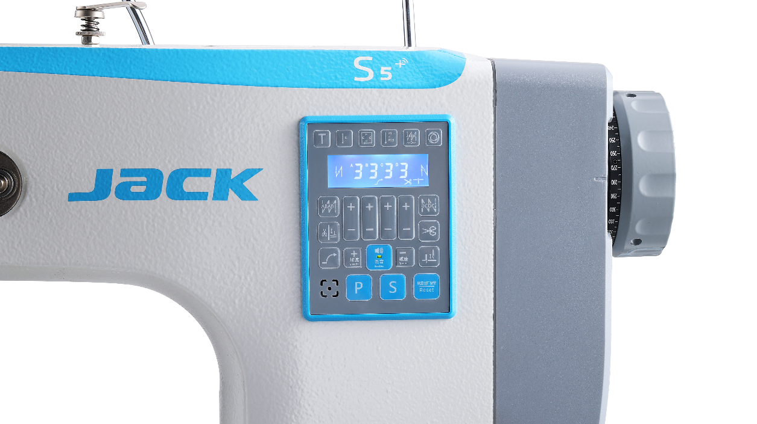
3.Embedded operation panel（8/9）
Embedded operation panel：It is convenient and simple for users to set and operate the electric control, and it is also more convenient and economical to replace.
Embedded operation panel

Slide 16
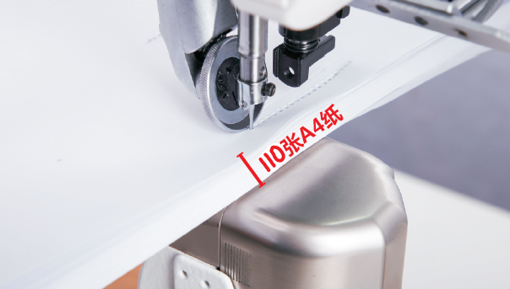
3.Strong puncture ability （9/9）
Strong puncture ability：It can penetrate more than 110 layers of A4 paper, and the super thick fabric of labor shoes can sew easily.
110 layers of A4 paper

Slide 17



